Slide 1
Unit 7

Slide 2
In computer graphics, we often need to draw different types of objects onto the screen.
Objects are not flat all the time and we need to draw curves many times to draw an object.

Slide 3
A curve is an infinitely large set of points.
Each point has two neighbours except endpoints.

Slide 4
Bezier curves are used in computer graphics to produce curves which appear reasonably smooth at all scales
As opposed to polygonal lines, which will not scale nicely.

Slide 5
Bezier Curve-

Slide 6
Bezier Curve may be defined as-
Bezier Curve is parametric curve defined by a set of control points.
Two points are ends of the curve.
Other points determine the shape of the curve.
The concept of bezier curves was given by Pierre Bezier.

Slide 7
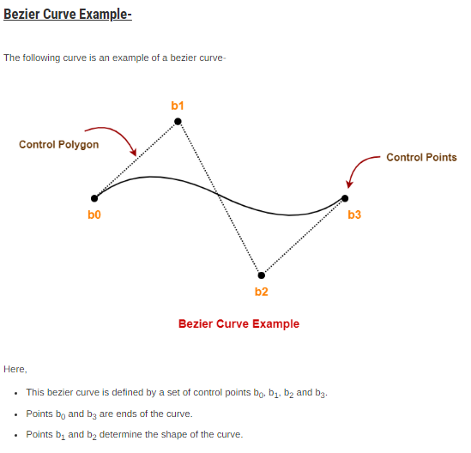

Slide 8
Parametric Curves
Curves having parametric form are called parametric curves.
A two-dimensional parametric curve has the following form −
P(t) = x(t), y(t)
The point p(t) depends on the x, y coordinates on the curve, and the points are obtained when the parameter t is varied over a certain interval

Slide 9
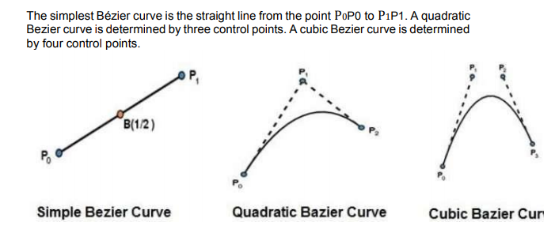
Different forms of Bezier curves

Slide 10
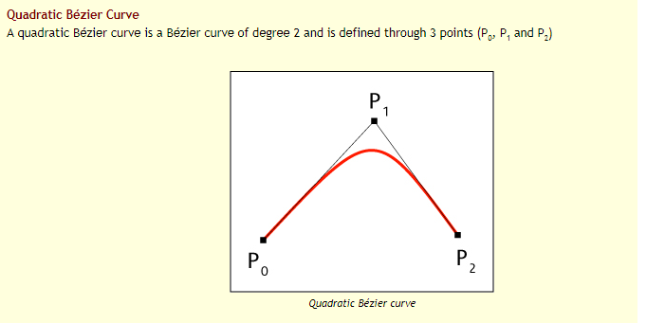

Slide 11
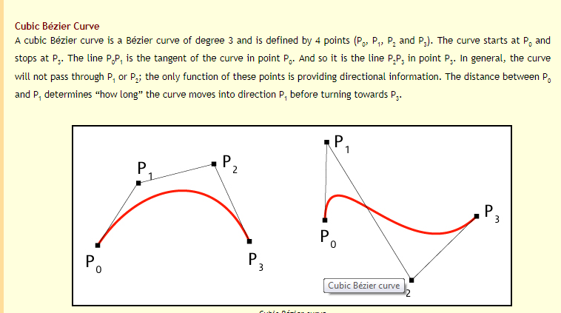

Slide 12
Properties of Bezier curve

Slide 13
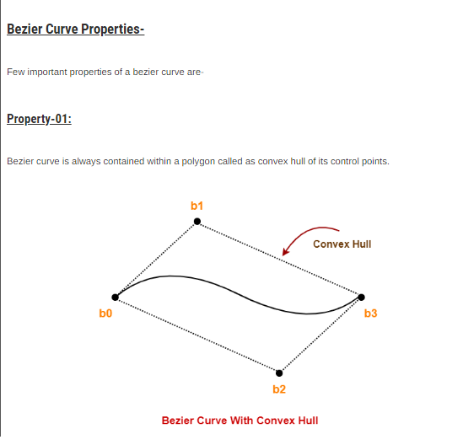

Slide 14
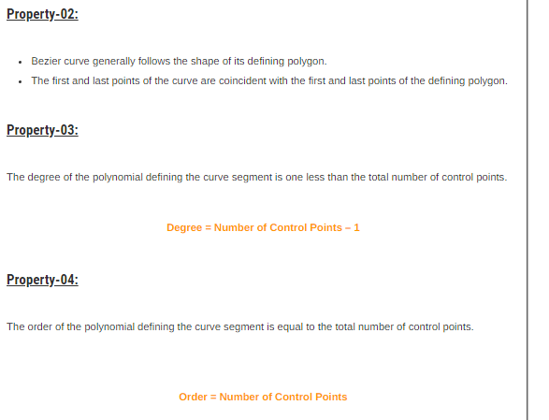

Slide 15
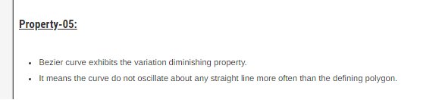

Slide 16
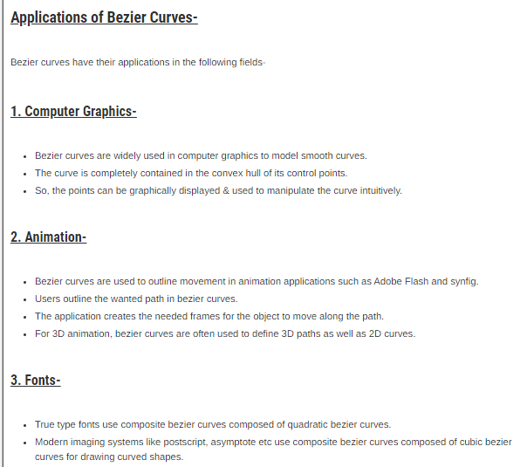

Slide 17
Interactive demo of control points with curve formation
http://www.e-cartouche.ch/content_reg/cartouche/graphics/en/html/Curves_learningObject2.html

